Slide 1


Slide 2

This Photo by Unknown Author is licensed under CC BY-NC

Slide 3
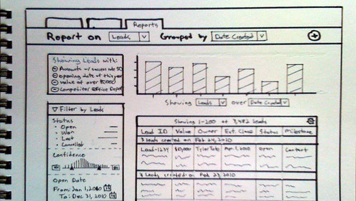
This Photo by Unknown Author is licensed under CC BY-ND

Slide 4

This Photo by Unknown Author is licensed under CC BY-SA-NC

Slide 5







This Photo by Unknown Author is licensed under CC BY-SA
This Photo by Unknown Author is licensed under CC BY-ND
This Photo by Unknown Author is licensed under CC BY-NC-ND
This Photo by Unknown Author is licensed under CC BY-NC
This Photo by Unknown Author is licensed under CC BY-SA-NC

Slide 6

This Photo by Unknown Author is licensed under CC BY

Slide 7

This Photo by Unknown Author is licensed under CC BY-SA

Slide 8


Slide 9


Slide 10
This Photo by Unknown Author is licensed under CC BY-SA-NC

Slide 11

This Photo by Unknown Author is licensed under CC BY-SA

Slide 12

This Photo by Unknown Author is licensed under CC BY

Slide 13


Slide 14
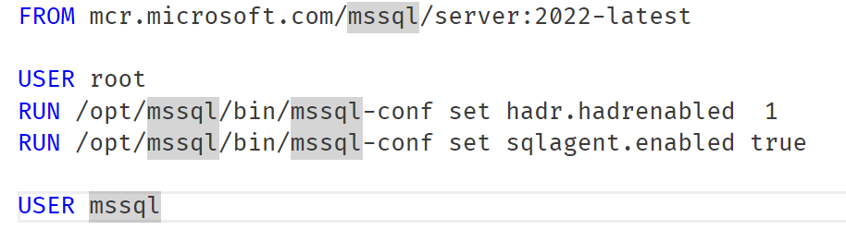

Slide 15
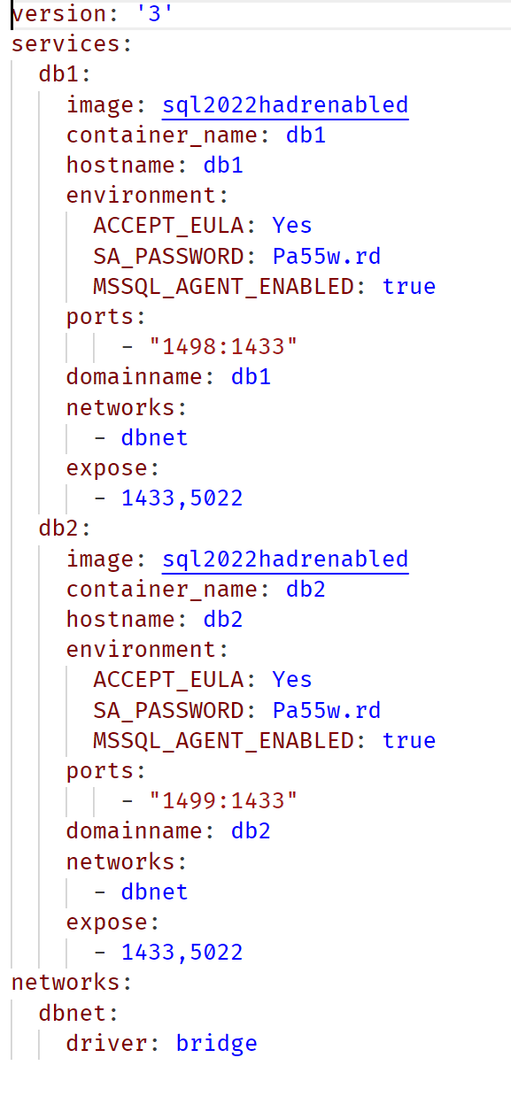

Slide 16
--blablabla some code to create an availability group and backup keys and stuff
CREATE AVAILABILITY GROUP [agsandbox]
WITH (AUTOMATED_BACKUP_PREFERENCE = SECONDARY,
DB_FAILOVER = OFF,
DTC_SUPPORT = NONE,
CLUSTER_TYPE = NONE,
REQUIRED_SYNCHRONIZED_SECONDARIES_TO_COMMIT = 0)
FOR DATABASE [sandbox]
REPLICA ON
N'db2' WITH (ENDPOINT_URL = N'TCP://db2:5022', FAILOVER_MODE = MANUAL, AVAILABILITY_MODE = SYNCHRONOUS_COMMIT, BACKUP_PRIORITY = 50, SEEDING_MODE = AUTOMATIC, SECONDARY_ROLE(ALLOW_CONNECTIONS = ALL)),
N'db1' WITH (ENDPOINT_URL = N'TCP://db1:5022', FAILOVER_MODE = MANUAL, AVAILABILITY_MODE = SYNCHRONOUS_COMMIT, BACKUP_PRIORITY = 50, SEEDING_MODE = AUTOMATIC, SECONDARY_ROLE(ALLOW_CONNECTIONS = ALL));
GO
BACKUP CERTIFICATE db1cert
--blablabla

Slide 17
Then copy some keys and stuff from db1 to db2
docker cp db1:/var/opt/mssql/data/db1cert.cer .
docker cp db1:/var/opt/mssql/data/db1cert.pvk .
docker cp .\db1cert.cer db2:/var/opt/mssql/data
docker cp .\db1cert.pvk db2:/var/opt/mssql/data

Slide 18
